Slide 1
Recurrent Neural Networks
RNN

Slide 2
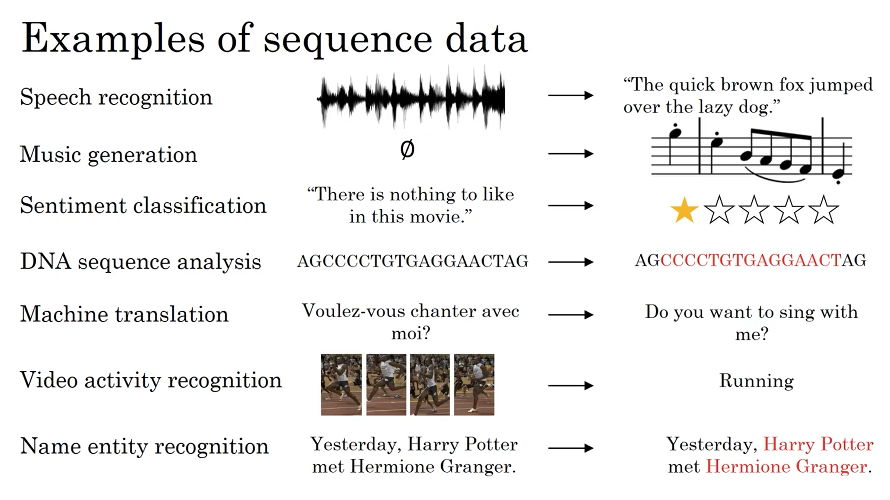
All these task can ba faced as supervised learning
mapping input x to output y

Slide 3
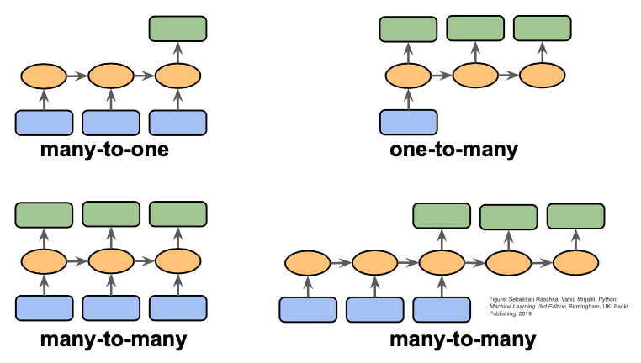
Different types of Sequence Modeling Tasks

Slide 7
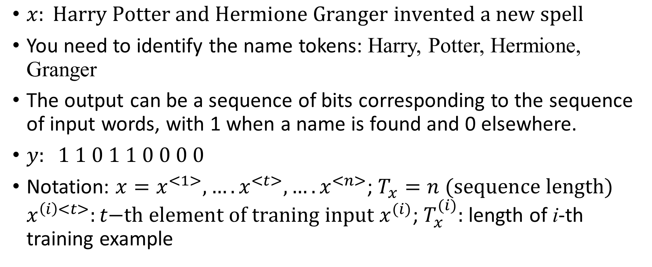
Motivating example: name entity recognition
$x: \text{Harry} \text{Potter} \text{and} \text{Hermione} \text{Granger} \text{invented} \text{a} \text{new} \text{spell}$
You need to identify the name tokens: Harry, Potter, Hermione, Granger
The output can be a sequence of bits corresponding to the sequence of input words, with 1 when a name is found and 0 elsewhere.
$y: 1 1 0 1 1 0 0 0 0$
Notation: $x=x^{<1>},….x^{<t>},….x^{<n>}$; $T_{x}=n \text{(}\text{sequence} \text{length}\text{)}$
$x^{\left(i\right)<t>}:t\text{−}\text{th} \text{element} \text{of} \text{traning} \text{input} x^{(i)}$; $T_{x}^{(i)}:$ length of i-th training example

Slide 8
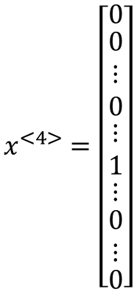
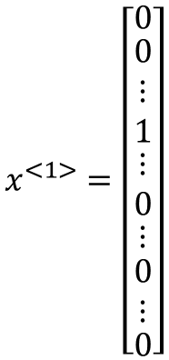
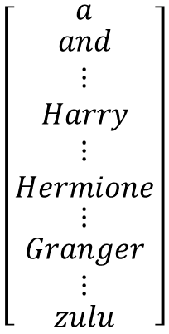
NLP example: representing words
One-hot encoding: given a fixed-size vocabulary vector, put 1 for the word position and 0 elsewhere
Vocabulary
$$\left[\begin{matrix}a \\ \begin{matrix}and \\ ⋮ \\ Harry\end{matrix} \\ \begin{matrix}⋮ \\ Hermione \\ \begin{matrix}⋮ \\ \begin{matrix}Granger \\ ⋮\end{matrix} \\ zulu\end{matrix}\end{matrix}\end{matrix}\right]$$
$$x^{<1>}=\left[\begin{matrix}0 \\ \begin{matrix}0 \\ ⋮ \\ 1\end{matrix} \\ \begin{matrix}⋮ \\ 0 \\ \begin{matrix}⋮ \\ \begin{matrix}0 \\ ⋮\end{matrix} \\ 0\end{matrix}\end{matrix}\end{matrix}\right]$$
$$x^{<4>}=\left[\begin{matrix}0 \\ \begin{matrix}0 \\ ⋮ \\ 0\end{matrix} \\ \begin{matrix}⋮ \\ 1 \\ \begin{matrix}⋮ \\ \begin{matrix}0 \\ ⋮\end{matrix} \\ 0\end{matrix}\end{matrix}\end{matrix}\right]$$
$$y=\left(y^{<1>},y^{<2>},…..y^{<9>}\right)=(1,1,0,1,1,0,0,0,0)$$

Slide 9
Why not a standard network?
Problems:
  Inputs and outputs can be of different lengths in different examples
  Does not share features learned across different positions (as in CNN if I learn that Harry in position 1 is a name, I would like to automatically discover that Harry in position 13 is also a name)

Slide 10


1D Convolution
$$238$$
$$161$$
$$1×1+20×3+15×10+3×3+18×1=238$$
$$20×1+15×3+3×10+3×18+12×1=$$

Slide 11

















RNN: Recurrent Neural Network
$$W_{ya}$$
$$W_{ya}$$
$$W_{ya}$$
$$W_{ya}$$
$$y^{<t>}$$
$$W_{ya}$$
0 vector
$$W_{aa}$$
$$W_{aa}$$
$$W_{aa}$$
$$W_{aa}$$
$$W_{xa}$$
$$W_{xa}$$
$$W_{xa}$$
$$W_{xa}$$
$$W_{aa}$$
$$W_{xa}$$
$$x^{<t>}$$
unrolled
rolled

Slide 12















Forward propagation
$$W_{ya}$$
$$W_{ya}$$
$$W_{ya}$$
$$W_{ya}$$
$$W_{aa}$$
$$W_{aa}$$
$$W_{aa}$$
$$W_{aa}$$
$$W_{xa}$$
$$W_{xa}$$
$$W_{xa}$$
$$W_{xa}$$
$$a^{<t>}=g_{1}(W_{aa}a^{<t−1>}+W_{ax}x^{<t>}+b_{a})$$
$$g_{1}: \text{tanh}\text{/}\text{ReLU}$$
$${\hat{y}}^{<t>}=g_{2}(W_{ya}a^{<t>}+b_{y})$$
$$g_{2}: \text{logistic}\text{/}\text{softmax}$$

Slide 13






Simplified notation
$$a^{<t>}=g_{1}(W_{aa}a^{<t−1>}+W_{ax}x^{<t>}+b_{a})$$
$$W_{a=}{[W}_{aa}⋮W_{ax}]$$
$${\hat{y}}^{<t>}=g_{2}(W_{ya}a^{<t>}+b_{y})$$
$$W_{y=}W_{ya}$$
$$a^{<t>}=g_{1}(W_{a}[a^{<t−1>},x^{<t>}]+b_{a})$$
$${\text{if} a}^{<t−1>} \text{is} (100×1)⁡\text{then} W_{aa} \text{is} (100×100)$$
$${\text{if} x}^{<t>} \text{is} (10000×1)⁡\text{then} W_{ax} \text{is} (100×10000)$$
$${\hat{y}}^{<t>}=g_{2}(W_{y}a^{<t>}+b_{y})$$
$$\text{then} W_{a} \text{is} (100×10100)$$

Slide 14





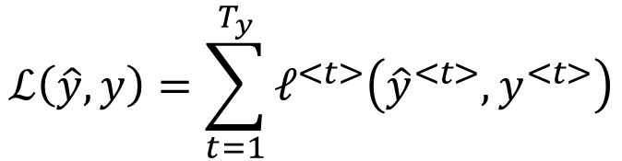


$$ℒ$$
$$ℓ^{<1>}$$
$$ℓ^{<2>}$$
$$ℓ^{<3>}$$
$$ℓ^{{<T}_{y>}}$$
$$W_{y}$$
$$W_{a}$$
$$ℓ^{<t>}\left({\hat{y}}^{<t>},y^{<t>}\right)=−y^{<t>}\log\left({\hat{y}}^{<t>}\right)−\left(1−y^{<t>}\right)log⁡(1−{\hat{y}}^{<t>})$$
$$ℒ\left(\hat{y},y\right)=\sum_{t=1}^{T_{y}}{ℓ^{<t>}\left({\hat{y}}^{<t>},y^{<t>}\right)}$$

Slide 15



Backpropagation through time
$$ℒ$$
$$ℓ^{<1>}$$
$$ℓ^{<2>}$$
$$ℓ^{<3>}$$
$$ℓ^{{<T}_{y>}}$$
$$W_{y}$$
$$\frac{∂ℓ^{<3>}}{∂a^{<3>}}$$
$$\frac{∂a^{<3>}}{∂a^{<2>}}$$
$$\frac{∂a^{<4>}}{∂a^{<3>}}$$
$$W_{a}$$
$$ℓ^{<t>}\left({\hat{y}}^{<t>},y^{<t>}\right)=−y^{<t>}\log\left({\hat{y}}^{<t>}\right)−\left(1−y^{<t>}\right)log⁡(1−y^{<t>})$$
$$ℒ\left(\hat{y},y\right)=\sum_{t=1}^{T_{y}}{ℓ^{<t>}\left({\hat{y}}^{<t>},y^{<t>}\right)}$$

Slide 16

Music generation
Sentiment classification
encoder
decoder
$$T_{x}=T_{y}$$
Entity recognition
Language translation

Slide 17
Language model and sequence generation

Slide 18
Speech recognition
Take a voice signal as input, provide a sequence of words (sentence) as output
Ambiguity (same pronunciation)
  The apple and pair salad was delicious
  The apple and pear salad was delicious
The second makes more sense
Task: computing the probability of a sentence and provide the most probable one as output

Slide 19
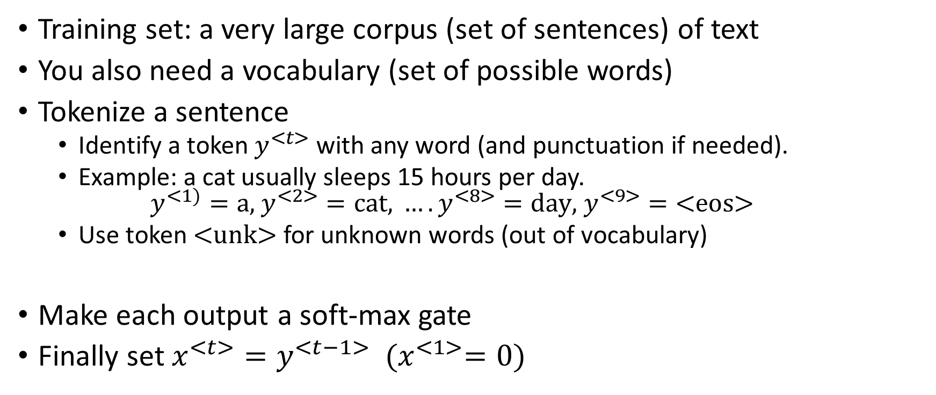
Language modeling with RNN
Training set: a very large corpus (set of sentences) of text
You also need a vocabulary (set of possible words)
Tokenize a sentence
  Identify a token $y^{<t>}$ with any word (and punctuation if needed).
  Example: a cat usually sleeps 15 hours per day.
  $y^{<1)}=\text{a}\text{, }y^{<2>}=\text{cat}\text{, }…. y^{<8>}=\text{day}\text{, }y^{<9>}=\text{<}\text{eos}\text{>}$
  Use token $\text{<}\text{unk}\text{>}$ for unknown words (out of vocabulary)
Make each output a soft-max gate
Finally set $x^{<t>}=y^{<t−1>} {(x}^{<1>}=0)$

Slide 20




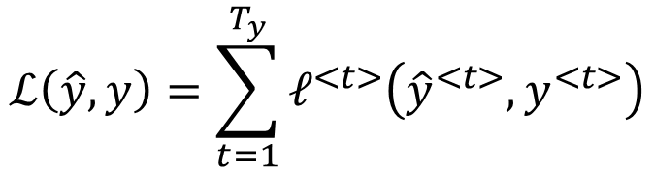





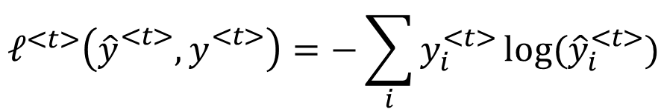







  $$y^{<1>}=\text{a}\text{, }y^{<2>}=\text{cat}\text{, }…. y^{<8>}=\text{day}\text{., }y^{<9>}=\text{<}\text{eos}\text{>}$$
Computing sentence
probability
$$P(\text{word})$$
$$P(\text{word}\text{|"}\text{a}\text{"})$$
$$P(\text{word}\text{| "}\text{a} \text{cat}\text{"})$$
$${\hat{y}}^{<1>}$$
$${\hat{y}}^{<2>}$$
$${\hat{y}}^{<3>}$$
$${\hat{y}}^{<9>}$$
$$0$$
$$a^{<1>}$$
$$a^{<2>}$$
$$a^{<3>}$$
$$a^{<t>}$$
$$x^{<1>}=0$$
$$x^{<2>}=y^{<1>}$$
$$x^{<3>}=y^{<2>}$$
$$x^{<9>}=y^{<8>}$$
a
cat
day.
$P\left(y^{<1>}\text{,}y^{<2>}, …y^{<8>},y^{<9>}\right)=P\left(y^{<1>}\right)P\left(y^{<2>} | y^{<1>}\right)P(y^{<3>}$| $y^{<1>}$ $y^{<2>})…$
$$P(y^{<9>}\text{| }y^{<1>}… y^{<8>})$$
$$ℒ\left(\hat{y},y\right)=\sum_{t=1}^{T_{y}}{ℓ^{<t>}\left({\hat{y}}^{<t>},y^{<t>}\right)}$$
$$ℓ^{<t>}\left({\hat{y}}_{}^{<t>},y_{}^{<t>}\right)=−\sum_{i}{y_{i}^{<t>}}log⁡({\hat{y}}_{i}^{<t>})$$

Slide 21
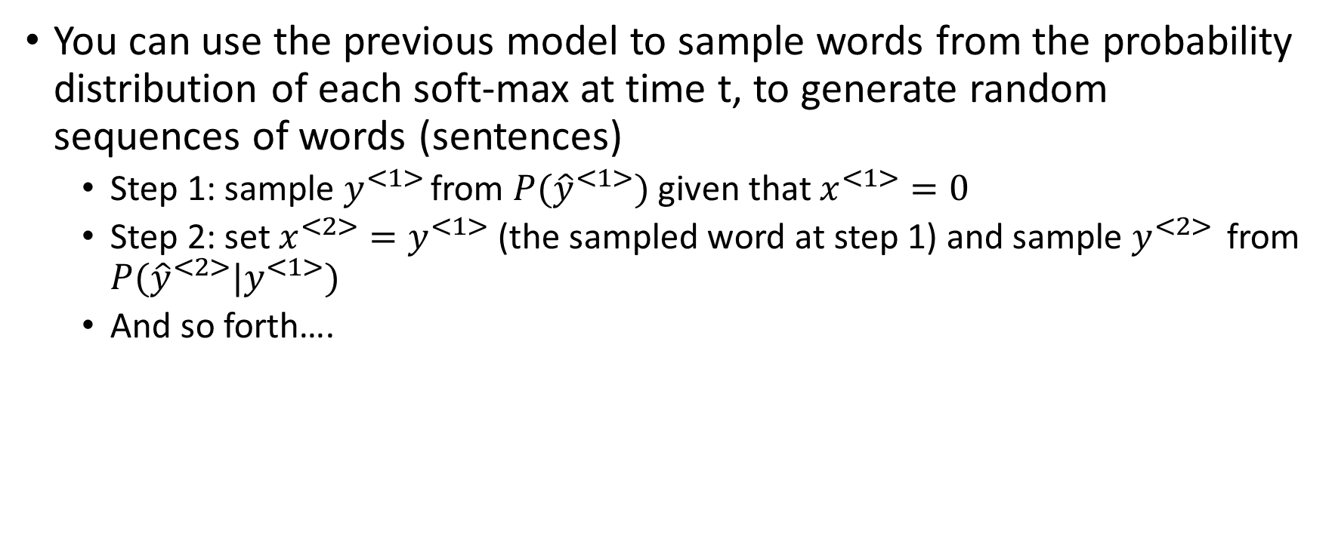
Generating random sentences
You can use the previous model to sample words from the probability distribution of each soft-max at time t, to generate random sequences of words (sentences)
  Step 1: sample $y^{<1> }$from $P({\hat{y}}^{<1>})$ given that $x^{<1>}=0$
  Step 2: set $x^{<2>}=y^{<1>}$ (the sampled word at step 1) and sample $y^{<2> }$ from $P({\hat{y}}^{<2>}|y^{<1>})$
  And so forth….

Slide 22
Sequence generation
Here are 2 examples of generated sentences when the language model is trained on a corpus of news (left) and on a corpus of Shakespeare texts (right)

Slide 23
Vocabulary
In most cases the vocabulary is based on words
In some cases it could be based on single characters
In the second situation the size of the vocabulary may become very very large
As more computational power becomes available, more frequent can become the use of character-based vocabularies…

Slide 24
Vanishing or exploding gradient
RNNs are very deep networks (100s of layers), thus they suffer from vanishing or exploding gradient (especially the standard formalism with tanh activation)
If the gradient is exploding we can use gradient clipping:
  To impose a maximum threshold and to rescale the values on that basis
To address vanishing gradient in RNN:
  GRU
  LSTM

Slide 25






Standard RNN
$$g=tanh$$
$$y^{<t>}$$
$$a^{<t>}=g(W_{a}\left[a^{<t−1>},x^{<t>}\right]+b_{a})$$
$$a^{<t−1>}$$
$$a^{<t>}$$
$$y^{<t>}=a^{<t>} \text{if} \text{regression}$$
$$y^{<t>}=softmax(a^{<t>}) \text{if} \text{classification}$$
$$x^{<t>}$$

Slide 26
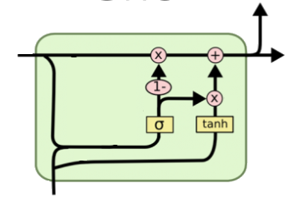









GRU (simplified)
$$y^{<t>}$$
$$c^{<t>}=\text{memory} \text{cell}$$
$${\tilde{c}}^{<t>}=tanh⁡(W_{c}\left[c^{<t−1>},x^{<t>}\right]+b_{c})$$
To capture long-term dependencies we store
here the current candidate prediction
$${c^{<t−1> =}a}^{<t−1>}$$
$${c^{<t>}=a}^{<t>}$$
$$Γ_{u}$$
$${\tilde{c}}^{<t>}$$
$$Γ_{u}=σ(W_{u}\left[c^{<t−1>},x^{<t>}\right]+b_{u})$$
Update Gate:
we model here the (soft) indicator to update (1) or
not (0) the current prediction
$$x^{<t>}$$
Element-wise multiplication
$$c^{<t>}=Γ_{u}∗{\tilde{c}}^{<t>}+(1−Γ_{u})∗c^{<t−1>}$$
When update close to 0 we keep previous value
otherwise we perform update with candidate prediction

Slide 27
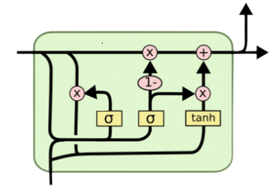










Full GRU
Add a reset gate $Γ_{r}$
$$y^{<t>}$$
$${\tilde{c}}^{<t>}=tanh⁡(W_{c}\left[c^{<t−1>},x^{<t>}\right]+b_{c})$$
$${\tilde{c}}^{<t>}=tanh⁡(W_{c}\left[Γ_{r}{∗c}^{<t−1>},x^{<t>}\right]+b_{c})$$
$$Γ_{r}=σ(W_{r}\left[c^{<t−1>},x^{<t>}\right]+b_{r})$$
$${c^{<t−1> =}a}^{<t−1>}$$
$${c^{<t>}=a}^{<t>}$$
$$Γ_{u}=σ(W_{u}\left[c^{<t−1>},x^{<t>}\right]+b_{u})$$
$$Γ_{r}$$
$$Γ_{u}$$
$${\tilde{c}}^{<t>}$$
$$c^{<t>}=Γ_{u}∗{\tilde{c}}^{<t>}+(1−Γ_{u})∗c^{<t−1>}$$
Reset controls how to consider the previous
prediction (0 do not consider, 1 fully consider)
$$x^{<t>}$$

Slide 28








LSTM: Long Short Term Memory
GRU
LSTM
$${\tilde{c}}^{<t>}=tanh⁡(W_{c}\left[Γ_{r}{∗c}^{<t−1>},x^{<t>}\right]+b_{c})$$
$${\tilde{c}}^{<t>}=tanh⁡(W_{c}\left[a^{<t−1>},x^{<t>}\right]+b_{c})$$
$$Γ_{r}=σ(W_{r}\left[c^{<t−1>},x^{<t>}\right]+b_{r})$$
$$Γ_{u}=σ(W_{u}\left[a^{<t−1>},x^{<t>}\right]+b_{u})$$
Update gate
$$Γ_{u}=σ(W_{u}\left[c^{<t−1>},x^{<t>}\right]+b_{u})$$
$$Γ_{f}=σ(W_{f}\left[a^{<t−1>},x^{<t>}\right]+b_{f})$$
Forget gate
$$Γ_{o}=σ(W_{0}\left[a^{<t−1>},x^{<t>}\right]+b_{o})$$
Output gate
$$c^{<t>}=Γ_{u}∗{\tilde{c}}^{<t>}+(1−Γ_{u})∗c^{<t−1>}$$
$$c^{<t>}=Γ_{u}∗{\tilde{c}}^{<t>}+Γ_{f}∗c^{<t−1>}$$
Use f to forget
$$c^{<t>}=a^{<t>}$$
$$a^{<t>}=Γ_{o}{∗tanh{(}c}^{<t>})$$
This models the possibility of keeping the old content or using the new candidate
This models the possibility of keeping the old content and adding it to the new candidate

Slide 29
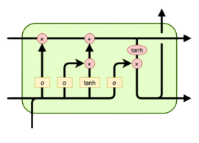















LSTM
$${\tilde{c}}^{<t>}=tanh⁡(W_{c}\left[a^{<t−1>},x^{<t>}\right]+b_{c})$$
$$Γ_{u}=σ(W_{u}\left[a^{<t−1>},x^{<t>}\right]+b_{u})$$
$$y^{<t>}$$
$$Γ_{f}=σ(W_{f}\left[a^{<t−1>},x^{<t>}\right]+b_{f})$$
$${c^{<t−1> } }^{}$$
$$c^{<t>}$$
$$Γ_{o}=σ(W_{0}\left[a^{<t−1>},x^{<t>}\right]+b_{o})$$
$$Γ_{u}$$
$$Γ_{0}$$
$$c^{<t>}=Γ_{u}∗{\tilde{c}}^{<t>}+Γ_{f}∗c^{<t−1>}$$
$$Γ_{f}$$
$${\tilde{c}}^{<t>}$$
$$a^{<t>}=Γ_{o}{∗tanh{(}c}^{<t>})$$
$$a^{<t−1>}$$
$$a^{<t>}$$
$$y^{<t>}=\text{softmax}\left(a^{<t>}\right) \text{classification}$$
$$y^{<t>}=a^{<t>} \text{regression}$$
$$x^{<t>}$$
Forget gate is used to forget/no forget past memory cell
Update gate is used to propose update of memory cell eventually composed with past value
Output gate is used to determine how much of memory cell to output

Slide 30
Notice that if forget and update gates are suitably set, a given content $c^{<i>}$ can be kept along the next time steps (memory)
NB dimensions of $a^{<t>} \text{and} c^{<t>}$are the same (In Keras they are the units argument of LSTM layer)

Slide 31
Current trends
Attention models
Transformers

Slide 32
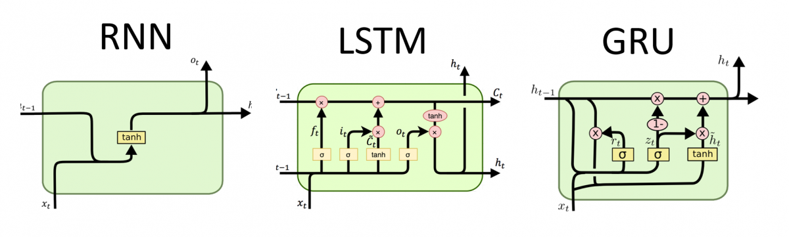

Slide 33
LSTM layer in Keras
from keras.layers import LSTM
LSTM(units,…return_sequence=False,…stateful=False)

Slide 34
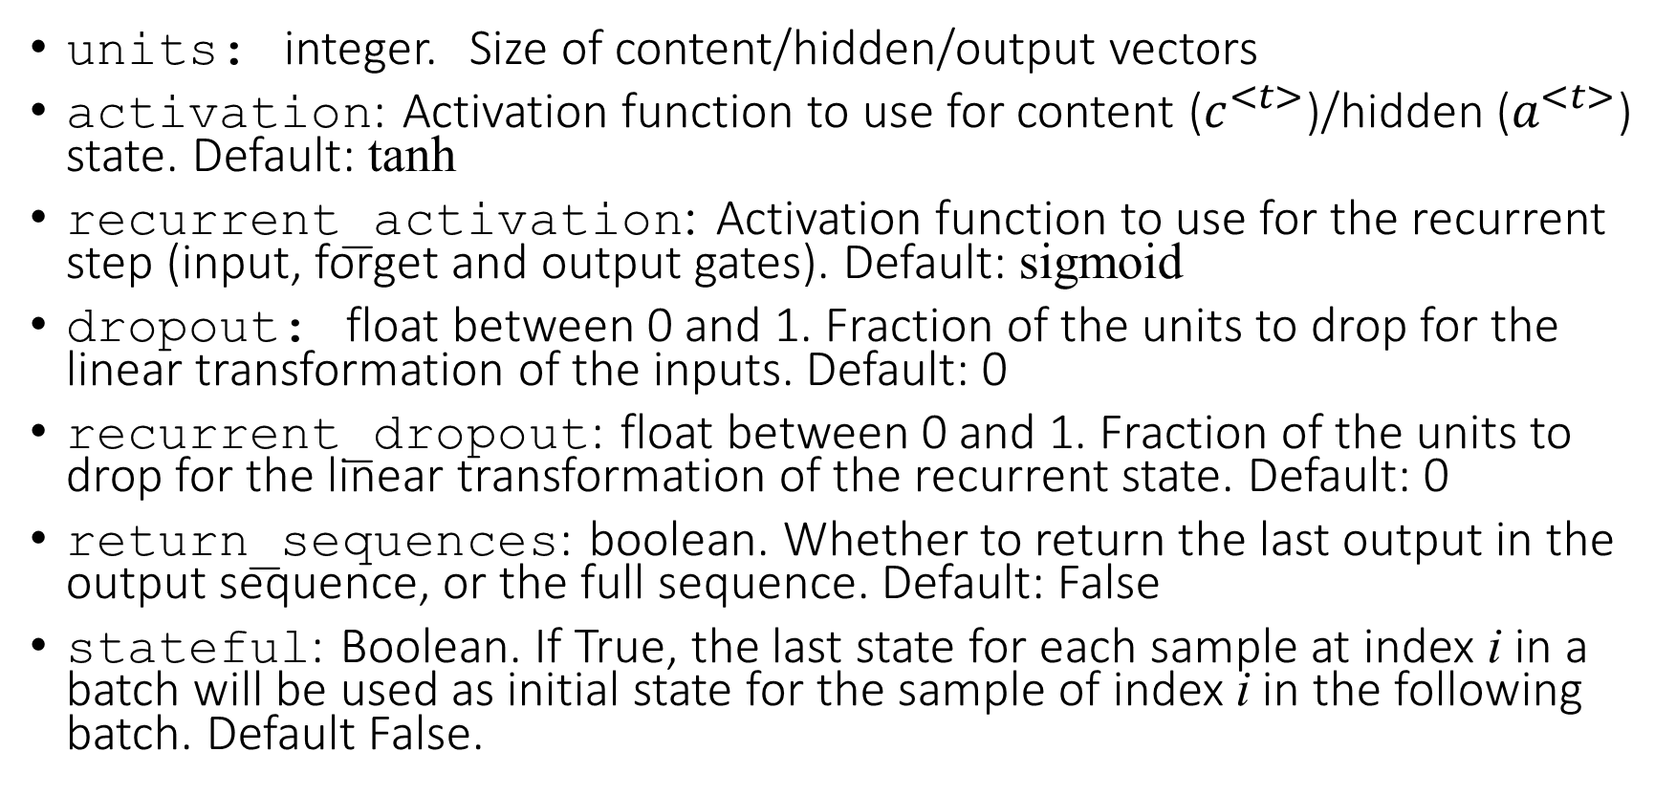
Main arguments
units: integer. Size of content/hidden/output vectors
activation: Activation function to use for content ($c^{<t>}$)/hidden ($a^{<t>}$) state. Default: tanh
recurrent_activation: Activation function to use for the recurrent step (input, forget and output gates). Default: sigmoid
dropout: float between 0 and 1. Fraction of the units to drop for the linear transformation of the inputs. Default: 0
recurrent_dropout: float between 0 and 1. Fraction of the units to drop for the linear transformation of the recurrent state. Default: 0
return_sequences: boolean. Whether to return the last output in the output sequence, or the full sequence. Default: False
stateful: Boolean. If True, the last state for each sample at index i in a batch will be used as initial state for the sample of index i in the following batch. Default False.

Slide 35
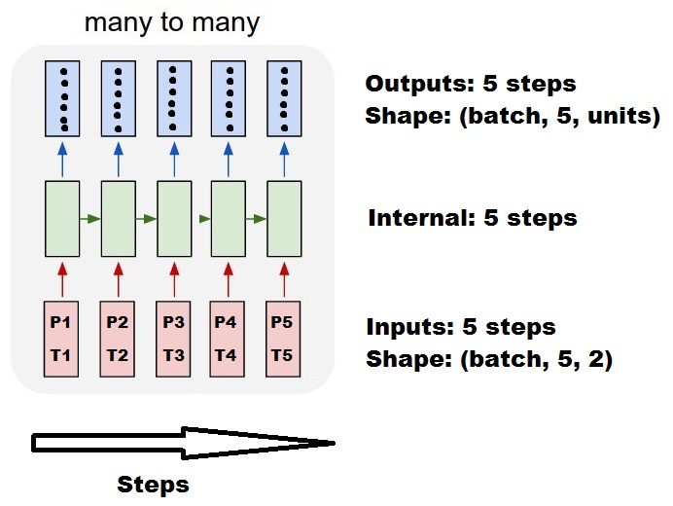

$$\text{features}\text{=}2 (P,T)$$
batch_size
time_steps
#features

Slide 36
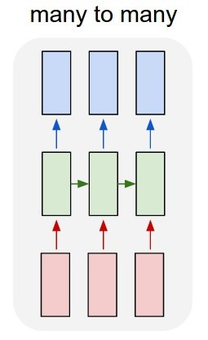
Standard
outputs = LSTM(units, return_sequences=True)(inputs)
#output_shape -> (batch_size, steps, units)

Slide 37
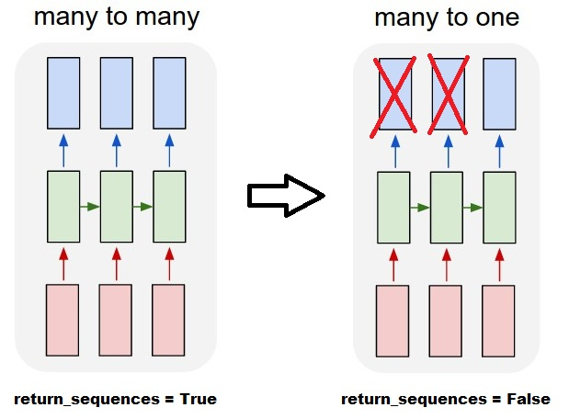
outputs = LSTM(units)(inputs)
#output_shape -> (batch_size, units) --> steps were discarded,
#only the last was returned

Slide 38
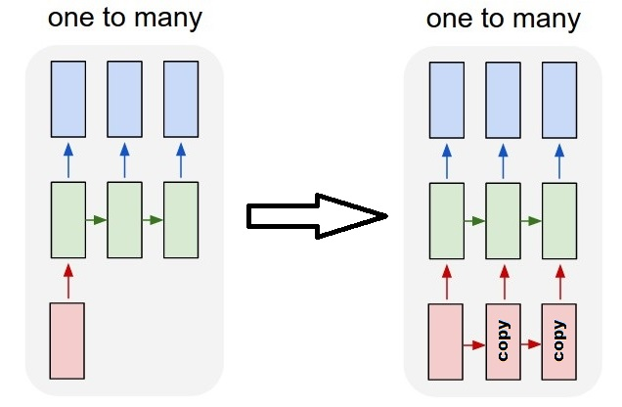
One-to-many with repeated input
outputs = RepeatVector(steps)(inputs) #where inputs is (batch,features)
outputs = LSTM(units,return_sequences=True)(outputs)
#output_shape -> (batch_size, steps, units)

Slide 39
Steteful LSTM vs Stateless LSTM
Stateless LSTM: after every batch the model is reset
Stateful=True: every new batch will be interpreted as continuing the previous batch; i.e, the sample sequence at index i is continued as the sample at index i in the next batch; for this reason if an LSTM is stateful, a complete input_shape must be provided (including batch size)
Serve quando c`è periodicità nelle sequenze e quindi devo divider I batch seguendo quella periodicit1a ed evitare
lo shuffling dell’input (la sequenza n.10 nel batch numero 1 e’correlate alla sequenza n. 10 del batch 2,3,4,….
https://medium.com/@jroessl/lstm-with-keras-4c4db55dd349
outputs = RepeatVector(steps)(inputs) #where inputs is (batch,features)
outputs = LSTM(units,return_sequences=True)(outputs)
#output_shape -> (batch_size, steps, units)

Slide 40
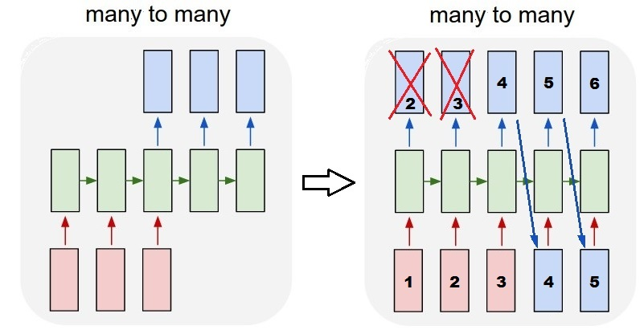
outputs = LSTM(units=features,
stateful=True,
return_sequences=True,
input_shape=(None,features))(inputs)
#units = features because we want to use the outputs as inputs
#None because we want variable length
#output_shape -> (batch_size, steps, units)
Predict:
model.reset_states() #starting a new sequence
predicted = model.predict(totalSequences)
firstNewStep = predicted[:,-1:]
#the last step of the pred. is the first future step
output_sequence = [firstNewStep]
last_step = firstNewStep
for i in steps_to_predict:
new_step = model.predict(last_step)
output_sequence.append(new_step)
last_step = new_step
#end of the sequences
model.reset_states()
Training:
totalSequences = someSequencesShaped((batch, steps, features))
#batch size is usually 1 in these cases
X = totalSequences[:,:-1] #the entire known sequence, except the last step
Y = totalSequences[:,1:] #one step ahead of X
#loop for resetting states at the start/end of the sequences:
for epoch in range(epochs):
model.reset_states()
model.train_on_batch(X,Y)

Slide 41
Attention e transformers
https://www.analyticsvidhya.com/blog/2019/11/comprehensive-guide-attention-mechanism-deep-learning/

